Slide 1




OSKAR HALECKI MEDAL
Dr. Alexander Maciej Jabłoński, P.Eng.
The Oskar Halecki Institute in Canada
The 5th Oskar Halecki Symposium

Slide 2
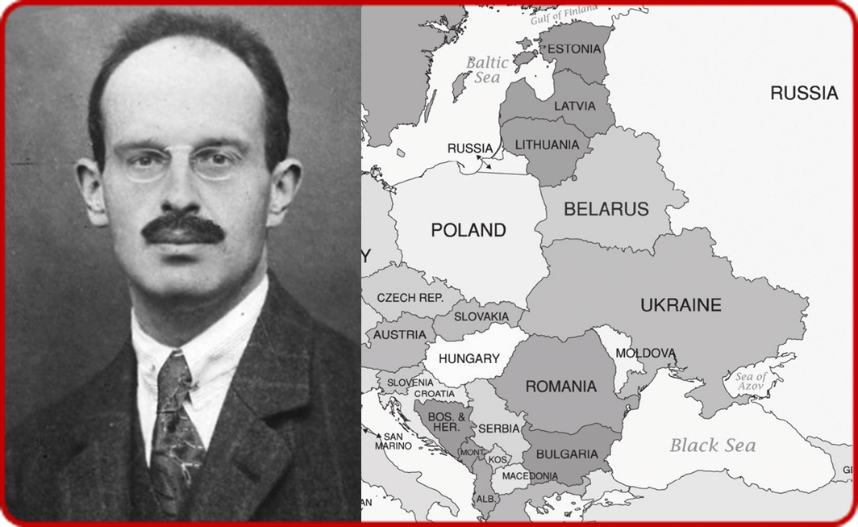
Contents
The idea of the Oskar Halecki Medal
Legacy Professor Oskar Halecki, Jr.
(1891 – 1973)
Medal description

Slide 3
The idea of Oskar Halecki Medal
Commemoration of 50. Anniversary of His death in-exile in the U.S.
Remembering Intermarium
10. Anniversary of establishment of the Oskar Halecki Institute in Canada
Medal description

Slide 4
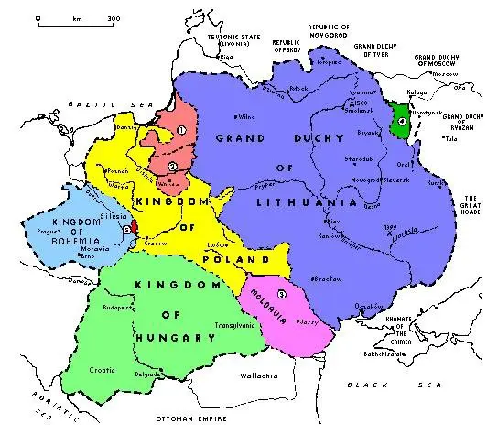
Jagiellonian Intermarium
1525

Slide 5
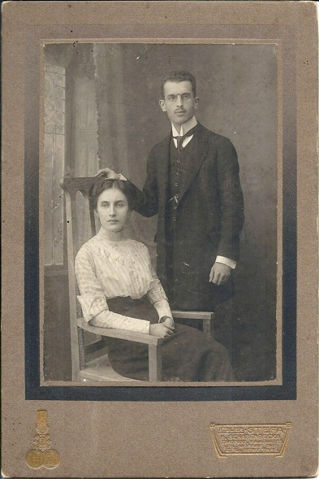


Professor Oskar Halecki vel Chalecki – early years
Born in 1891 in Viennna, a son of the Austrian-Hungarian Field Marshall - Oskar Aloysius Halecki vel Chalecki Ritter von Nordenhorst (1838-1903) & Leopoldina Delimaniĉ (1856-1943) of Croatian aristocracy.
1909 - 1913 Studied history at the Jagiellonian University (UJ) in Cracow
In 1913 Oskar Halecki married Helena neé Szarłowski
1913 - Defended Ph.D. in History
Zgoda Sandomierska 1570
Settlement of Sandomierz 1570
Supervisor: Prof. Stanisław Krzyżanowski
1914 - Studied at University of Vienna
1915 - D.Sc. (Habilitation) at UJ
Chalecki
Oskar Jr. & Helena neé Szarłowski
Halecki vel Chalecki before before WWI
(Phot. Private collection of Prof. T Gromada)

Slide 6
Early Achievements
Publication of three monumental monographs in 1915:
Ostatnie lata Świdrygiełły i sprawa wołyńska za Kazimierza Jagiellończyka
The Last Years of Świdrygiełło and the Volhynian Case
Cracow 1915, 315 pages
Przyłączenie Podlasia, Wołynia i Kijowszczyzny do Korony w 1569
Annexion of Podlasie, Volhynia and Kiev Region to the Polish Crown in 1569
Cracow 1915, 245 pages
Zgoda Sandomierska 1570 r. Jej geneza i znaczenie w dziejach reformacji polskiej za Zygmunta Augusta
The Settlement in Sandomierz in 1570. Its Origin in the Times of Polish Reformation during the Reign of King Sigismund August
Warsaw 1915, 422 pages

Slide 7
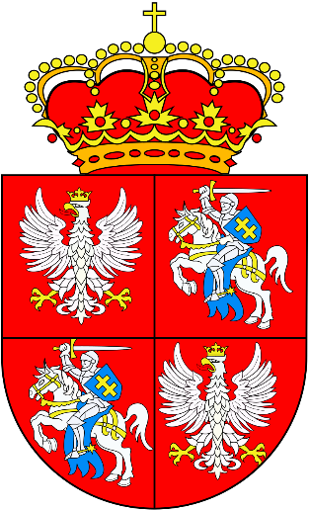
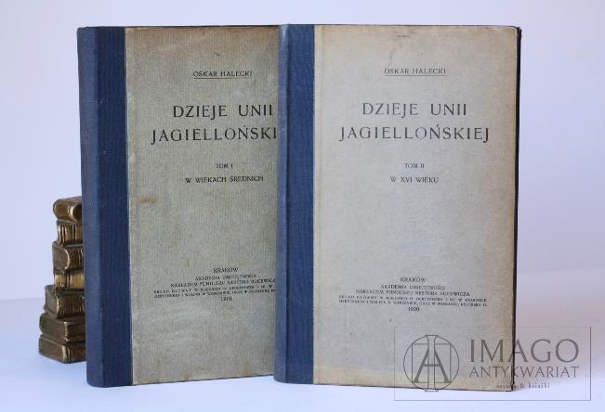

Polish-Lithuanian Union
  Monumental work published in 1919-1920 in two volumes:
Dzieje Unii Jagiellońskiej:
History of the Jagiellonian Union:
W wiekach średnich, t. 1
In the Middle Ages, Cracow 1919, pp. 482
W XVI wieku, t. 2
In the 16th Century, Cracow 1920, pp. 385

Slide 8
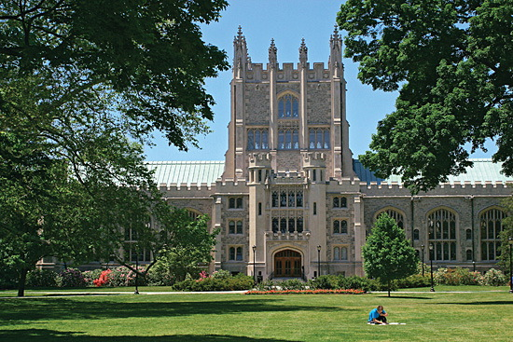
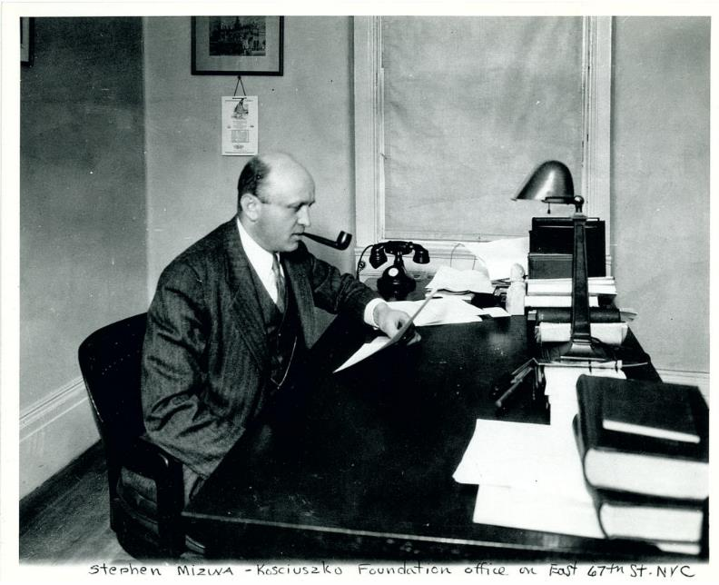
In America - Vassar College, NY
Vassar College, Pougkeespsie, NY (found. 1861) – first work site of Professor Oskar Halecki in the USA 1940 – 1942
(Wikipedia)
Stephen Mizwa (Mierzwa) at Kościuszko Foundation Office on East 67th St, NYC
(Kościuszko Foundation Archive)

Slide 9
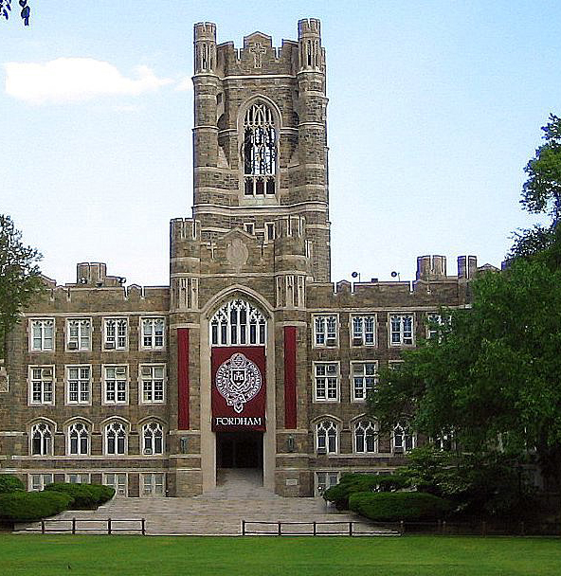

Fordham University, NY
Rev. Prof. Gustave Dumas, S.J., Dean, Faculty of Arts (on behalf of Rev. Prof. Robert I Gannon, Rector of Fordham University) invited Professor Oskar Halecki to chair the Department of Historical Studies in 1944
Prof. Oskar Halecki stayed at Fordham from 1944
to his death in 1973
Keating Hall, Fordham University, Bronx, New York, NY (zał. 1841)
(Wikipedia)

Slide 10

East Central Europe
In the 1950s Oskar Halecki published two important books:
The Limits and Division on European History – Shed & Ward, London 1950, 120 pages
Borderlands of Western Civilization: A History of East Central Europe, New York, 1952, 556 pages

Slide 11
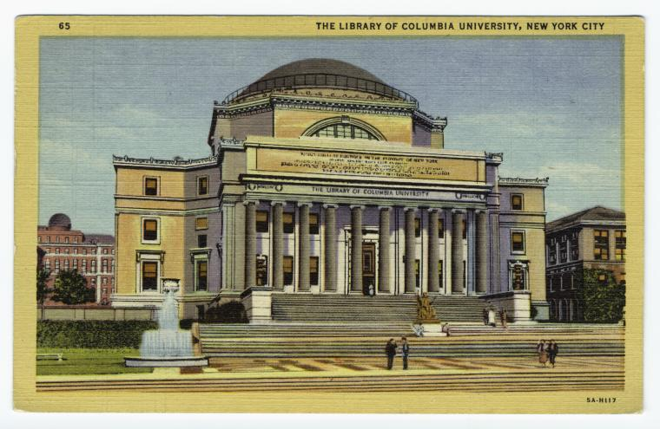

East Central Europe
In the course of European history, a great variety of peoples in this region (East Central Europe - AMJ) created their own independent states, sometimes quite large and powerful; in connection with Western Europe, they developed their individual national cultures and contributed to the general progress of European civilization – Oskar Halecki – Borderlands of Western Civilization
The Library of Columbia University, New York City

Slide 12

Selected books published in-exile
The Limits and Divisions of European History
New York 1950, 242 pages
The Borderlands of Western Civilization. A History of East Central Europe New York 1952, 503 pages
From Florence to Brest (1439 – 1596)
(in: Sacrum Poloniae Millennium - Studies - Essays – Documents)
Rome 1958, 444 pages
Un Empereur de Byzance á Rome
(Extended edition), London 1972, 532 pages

Slide 13

Legacy of Oskar Halecki, Jr.
Oskar Halecki passed away on September 17, 1973 r. in White Plains, New York and is buried in the local cemetery.
His legacy is present in His works written and published in many languages (but predominantly in English and Polish).

Slide 14
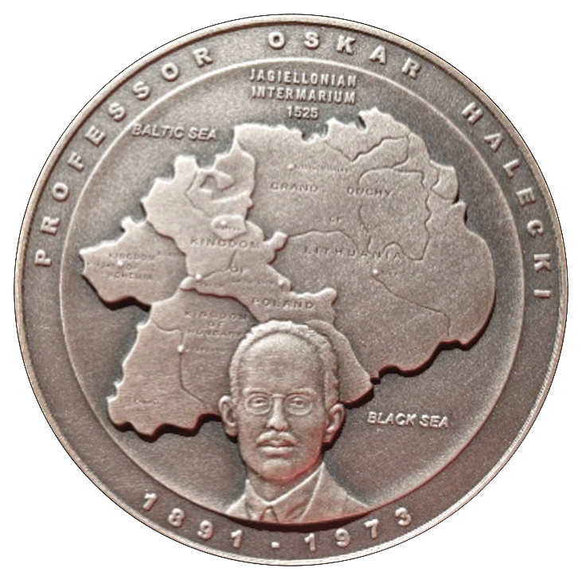
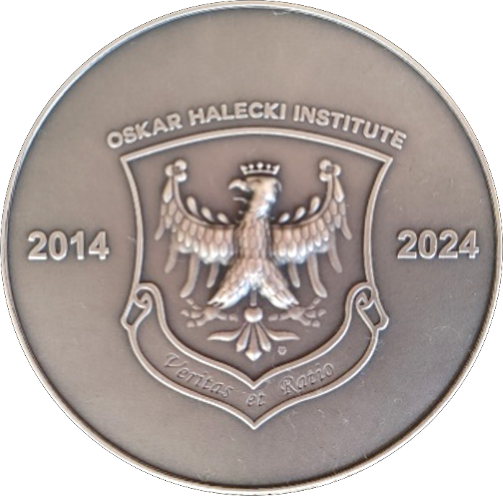
OSKAR HALECKI MEDAL

Slide 15
www.halecki.org

